Slide 1

Expression Based Music Player
PRESENTED BY:
Km Ankita (161500268)
Radhika Sharma(161500419)
Rambandhu Sharma(161500438)
Rajeev Kumar(171599007

Slide 2
CONTENTS
Introduction
Requirements
Overview
Mock ups and Wireframes
GUI screens
Working of App

Slide 3
Introduction
To develop an application that uses face recognition system to detect the facial expressions of a person using the inbuilt camera.
Based on the expressions system will assign mood to the user and start playing songs depending upon the mood from the playlist that will be created and filled by the user itself.

Slide 4
Requirements
Hardware Requirements
4GB RAM
Android Device
Intel i3/i5
Software Requirements
SQLite
Android Studio

Slide 5
Overview
This project focuses on creating an application to suggest songs for user based on their mood by capturing facial expressions.
Facial expression is a form of nonverbal communication

Slide 6
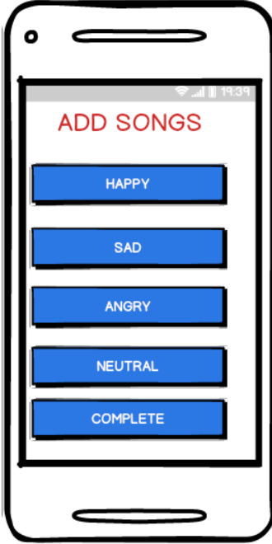
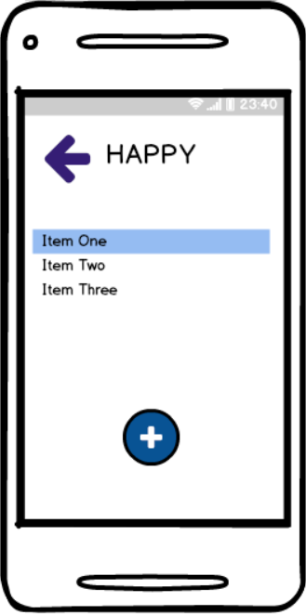
Moch Ups and Wireframes

Slide 7
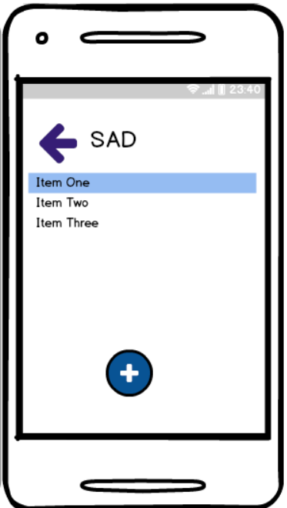
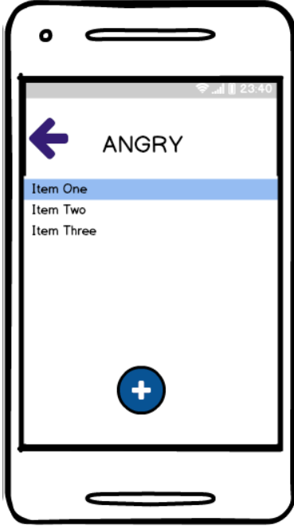

Slide 8
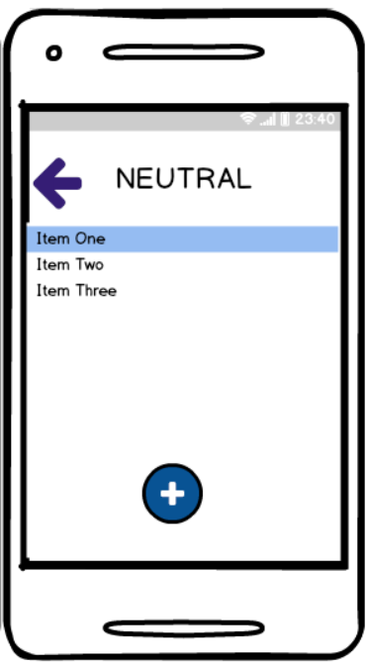


Slide 9
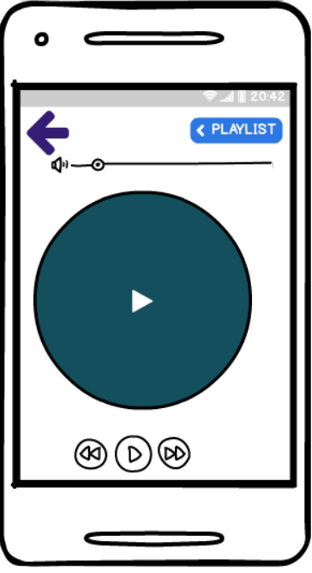

Slide 10
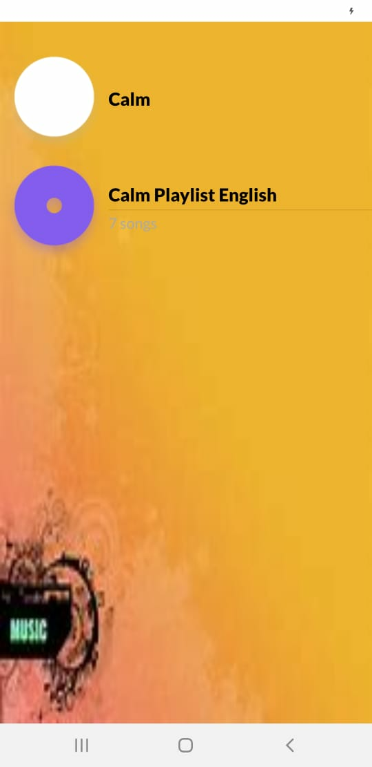
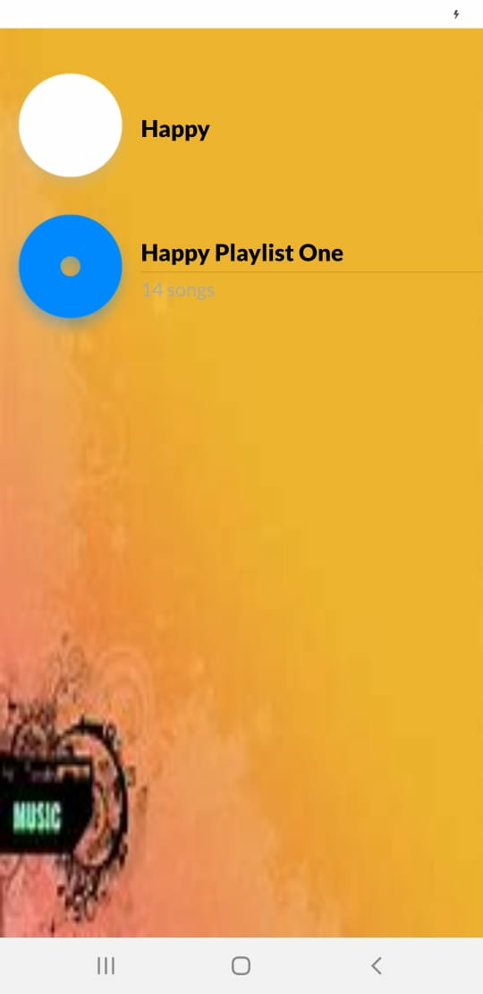
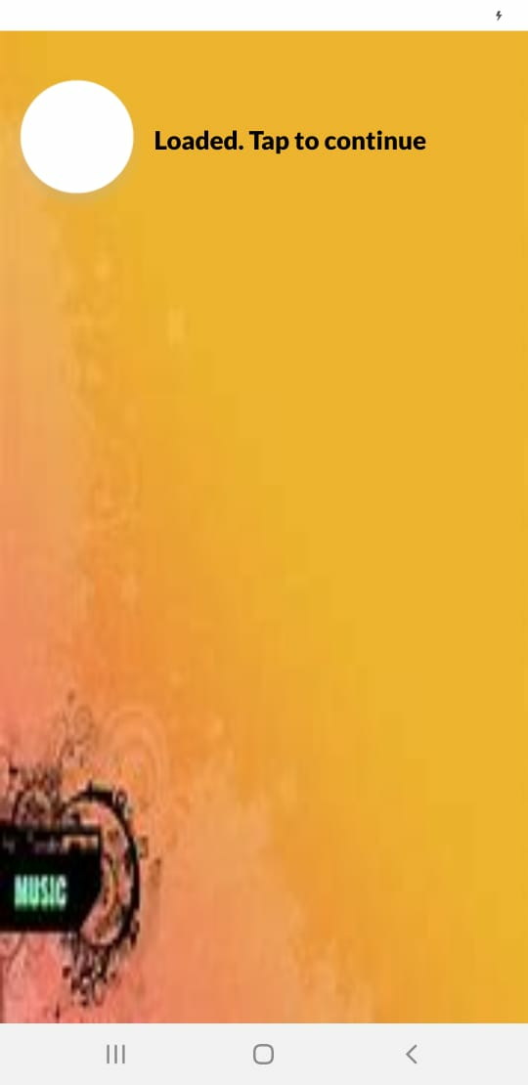
GUI Screens

Slide 11

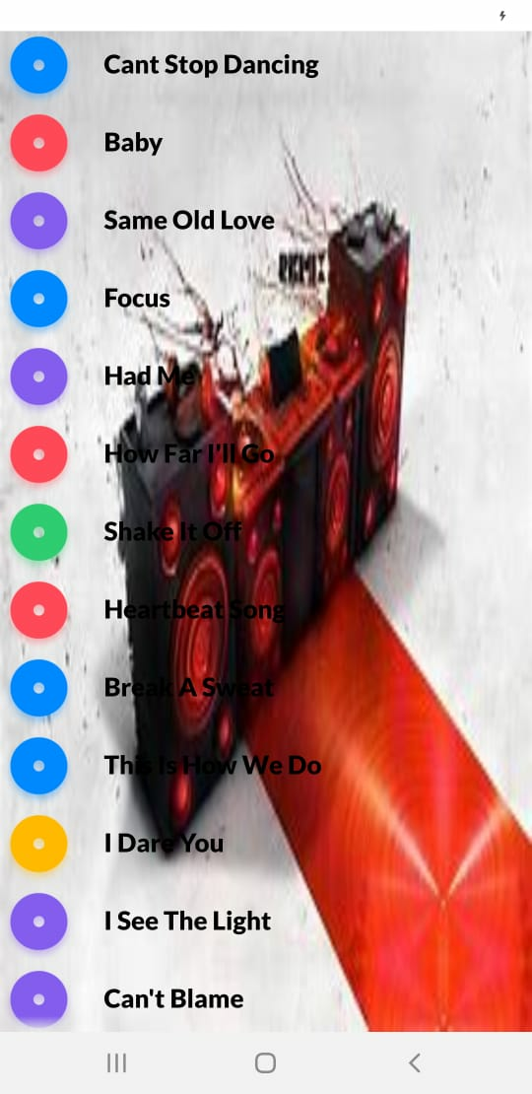
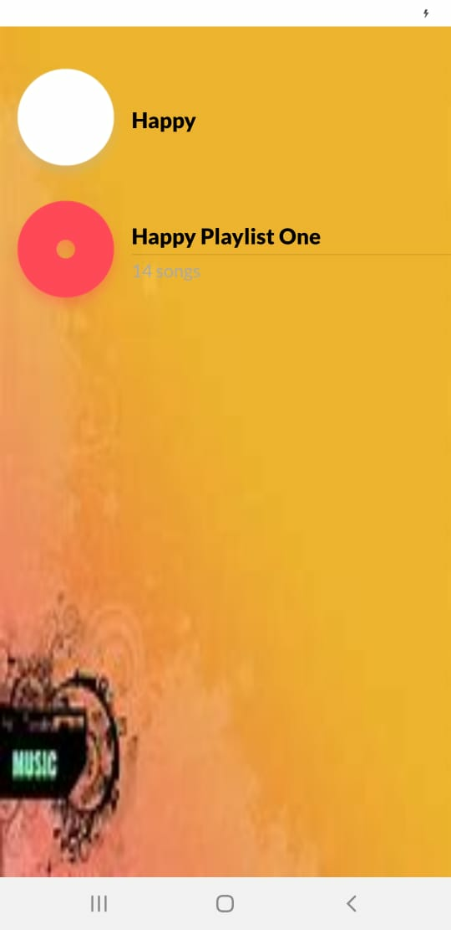

Slide 12
